Slide 1
PRODUCT SALES ANALYSIS

Slide 2
ABSTRACT
The "Product Sales Analysis" machine learning project aims to develop a predictive model that can analyze and forecast product sales based on historical data.
This project utilizes a dataset containing information about product attributes, sales channels, pricing, and time-related factors.

Slide 3
OBJECTIVES
Product sales analysis typically has several objectives, including:
Performance Evaluation, Identifying Trends, Customer Insights, Inventory Management, Competitive Analysis, Profitability Analysis, Marketing Effectiveness, Forecasting, Geographic Analysis, Product Lifecycle Management, Customer Retention, Identifying Growth Opportunities, Cost Reduction, Quality Improvement, Compliance and Reporting
By achieving these goals we would know about the sales, profit of the products.

Slide 4
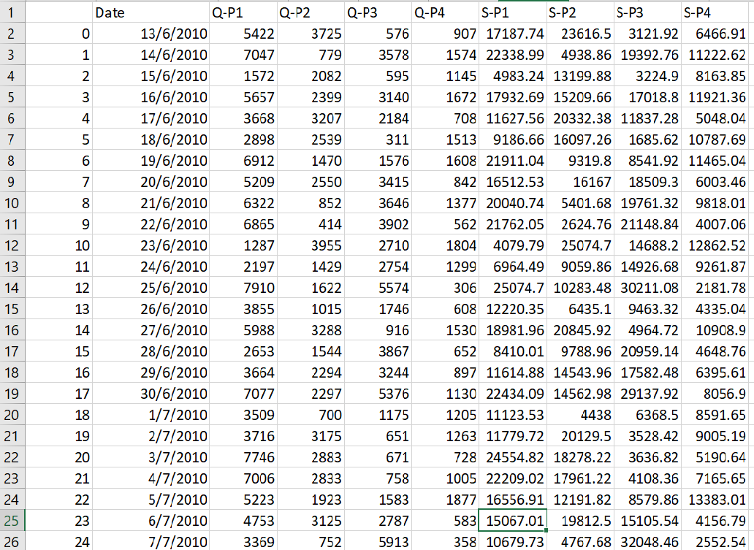
Data Source
Dataset Link:https://www.kaggle.com/datasets/ksabishek/product-sales-data

Slide 5
DATA PREPROCESSING
Clean the dataset: Check for missing values and outliers.
Convert the 'Date' column to a datetime format for time series analysis.
Create new features if needed, such as total sales, profit, or seasonality indicators.
1. Import Necessary Libraries:
We start by importing the required Python libraries: Pandas for data manipulation and Matplotlib for data visualization.
2. Read the Dataset:
- We read the dataset from a CSV file. You should replace `'your_dataset.csv'` with the actual file path where your dataset is located.

Slide 6
3. Handling Missing or Invalid Dates:
The code drops rows with missing or invalid date values using `data.dropna(subset=['Date'])`. If there are missing or invalid dates, this step ensures the dataset only contains valid date entries.
4.Customization:
You can modify these visualizations by selecting different columns or customizing the plots further. For more complex visualizations or additional analysis, you may need to explore other plotting libraries or techniques, but this code serves as a good starting point for basic data exploration and visualization.
Program:
import pandas as pd
import matplotlib.pyplot as plt
# Read the dataset into a Pandas DataFrame
data = pd.read_csv('statsfinal.csv') # Replace 'your_dataset.csv' with the actual file path if the data is in a CSV file
# Fill or drop any missing or invalid date values if needed
data = data.dropna(subset=['Date'])

Slide 7
print(data.info())
print(data.describe())
print(data.head())
# Visualization 1: Line plot of one of the numeric columns (e.g., Q-P1)
plt.figure(figsize=(12, 6))
plt.plot(data['Date'], data['Q-P1'])
plt.title('Q-P1 Over Time')
plt.xlabel('Date')
plt.ylabel('Q-P1 Value')
plt.grid(True)
plt.show()
# Visualization 2: Scatter plot between two numeric columns (e.g., Q-P1 vs. S-P1)
plt.figure(figsize=(10, 8))
plt.scatter(data['Q-P1'], data['S-P1'], alpha=0.5)
plt.title('Scatter Plot: Q-P1 vs. S-P1')
plt.xlabel('Q-P1')
plt.ylabel('S-P1')
plt.grid(True)
plt.show()

Slide 8
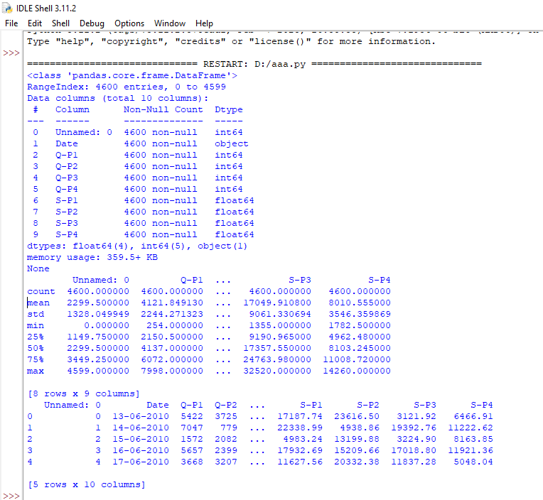
# Visualization 3: Histogram of a numeric column (e.g., Q-P1)
plt.figure(figsize=(10, 6))
plt.hist(data['Q-P1'], bins=20, edgecolor='k')
plt.title('Histogram of Q-P1')
plt.xlabel('Q-P1 Value')
plt.ylabel('Frequency')
plt.grid(True)
plt.show()
OUTPUT:

Slide 9
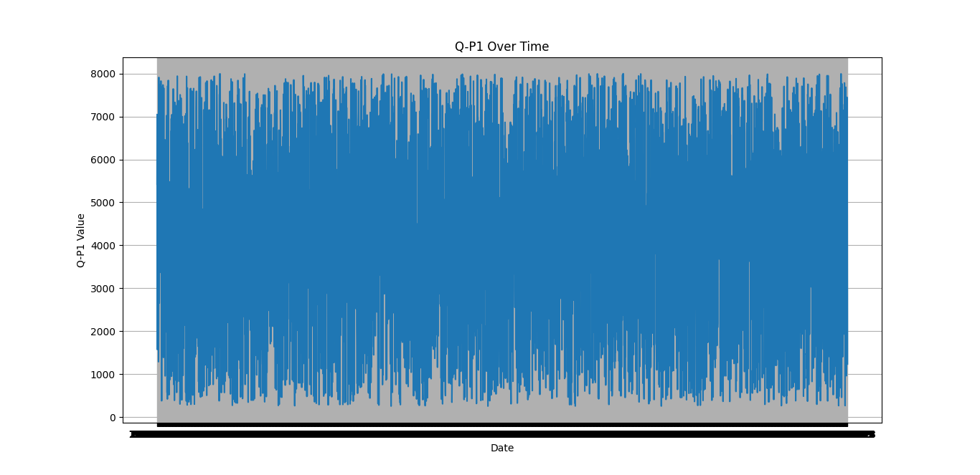

Slide 10
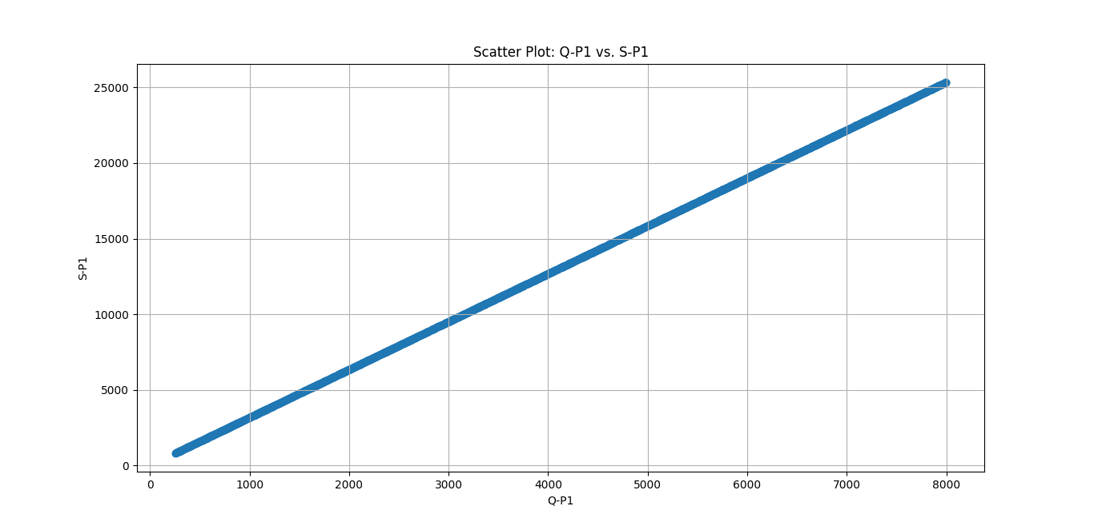

Slide 11
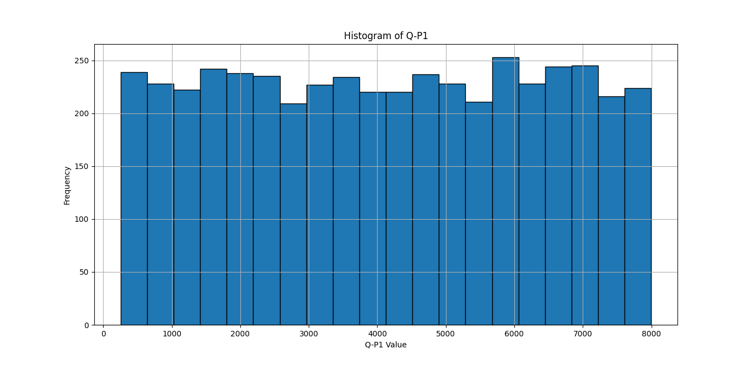

Slide 12
CONCLUSION
The project aims to help businesses optimize their operations, maximize sales, and improve customer satisfaction. It provides a comprehensive solution for analyzing historical sales data and leveraging machine learning techniques to make informed business decisions.
Please note that this is a high-level overview, and the specific implementation details and choice of machine learning models may vary based on the characteristics of your dataset and the goals of your analysis.

Slide 13
THANK
YOU

